Slide 1
PURESOFTWARE
CORPORATE OVERVIEW

Slide 2
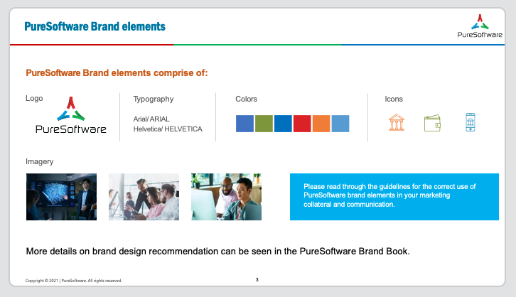
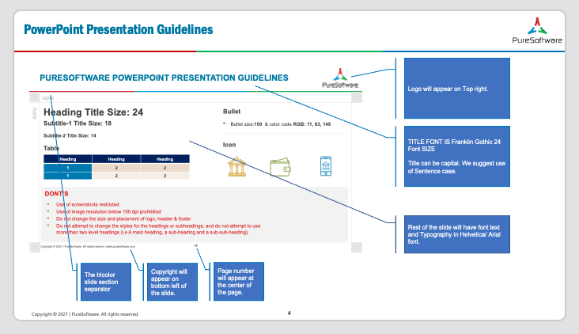
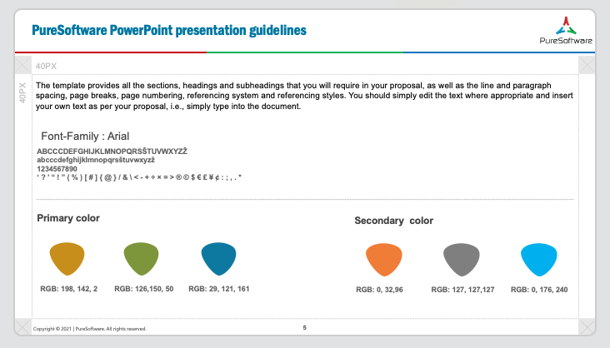
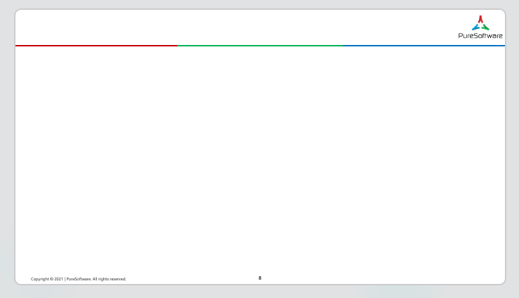
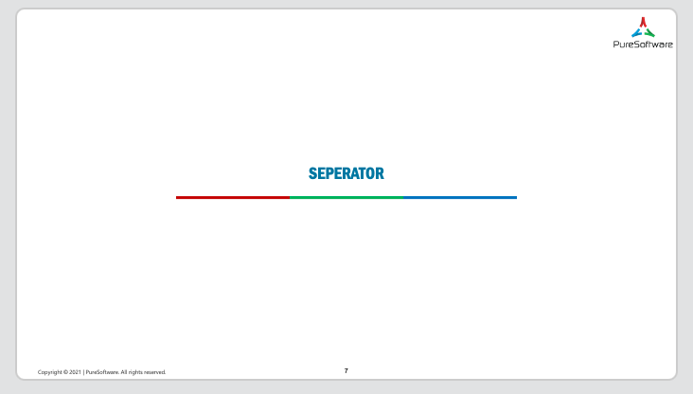

TABLE OF CONTENTS
PureSoftware PPT Template Guidelines
Brand Elements
Slide Structure
Fonts and Colors
PureSoftware PPT Template
Content Slide
Separator
Thank you

Slide 3







PURESOFTWARE BRAND ELEMENTS COMPRISE OF:
PURESOFTWARE BRAND ELEMENTS
Logo
Typography
Colors
Icons
Arial/ ARIAL
Helvetica/ HELVETICA
Imagery
Please read through the guidelines for the correct use of PureSoftware brand elements in your marketing collateral and communication.
More details on brand design recommendation can be seen in the PureSoftware Brand Book.

Slide 4
POWERPOINT PRESENTATION GUIDELINES
Logo will appear on Top right.
TITLE FONT IS Franklin Gothic 24 Font SIZE
Title can be capital. We suggest use of Sentence case.
Rest of the slide will have font text and Typography in Helvetica/ Arial font.
The tricolor slide section separator
Copyright will appear on bottom left of the slide.
Page number will appear at the center of the page.

Slide 5







PURESOFTWARE POWERPOINT PRESENTATION GUIDELINES
40PX
40PX
The template provides all the sections, headings and subheadings that you will require in your proposal, as well as the line and paragraph spacing, page breaks, page numbering, referencing system and referencing styles. You should simply edit the text where appropriate and insert your own text as per your proposal, i.e., simply type into the document.
Font-Family : Arial
ABCCCDEFGHIJKLMNOPQRSŠTUVWXYZŽ
abcccdefghijklmnopqrsštuvwxyzž
1234567890
‘ ? ’ “ ! ” ( % ) [ # ] { @ } / & \ < - + ÷ × = > ® © $ € £ ¥ ¢ : ; , . *
Primary color
Secondary color
RGB: 198, 142, 2
RGB: 126,150, 50
RGB: 29, 121, 161
RGB: 0, 32,96
RGB: 127, 127,127
RGB: 0, 176, 240

Slide 7
SEPERATOR

